Slide 1
Trimaran-3 An overcommitment-aware scheduler Demonstration
Asser Tantawi
IBM Research

Slide 2
Demo scenarios
Scenario I
Burstable pods spike their resource usage (CPU and/or memory) initially, then usage goes down considerably
If pods are scheduled on same node, they run into throttling and/or OOM
Example: Spring Boot applications
Scenario II
Burstable, compute-intensive workload (TBD)

Slide 3
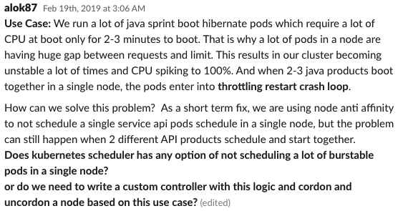
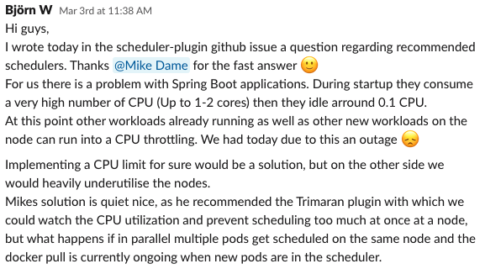
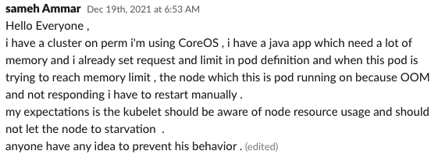
Scenario I

Slide 4
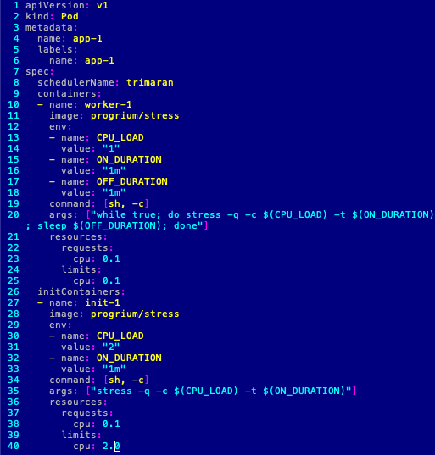
Pod spec
container | request | limit | usage
init | 0.1 | 2.0 | 2.0
main | 0.1 | 0.1 | 0.05
cores
2.0
init
main
0.1
time

Slide 5
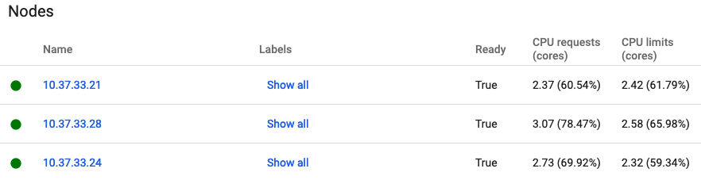
Cluster config
4.0
2.37
0.1
2.0
node-21
app-1
2.73
node-24
app-2
3.07
app-3
node-28
allocated
capacity

Slide 6
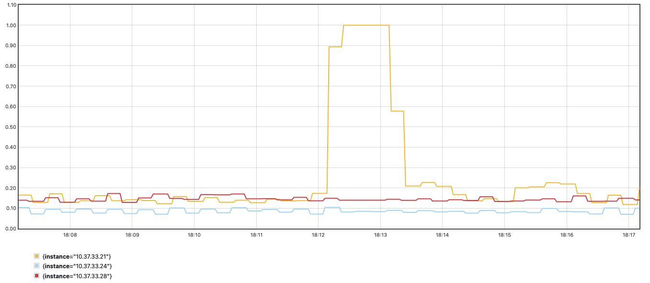
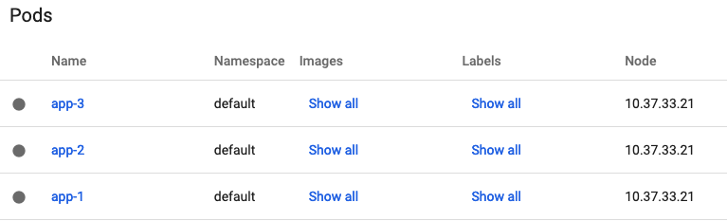
100%
Default
utilization
overcommitment
node-21
app-1
app-2
app-3
node-24
node-28
allocated
capacity

Slide 7
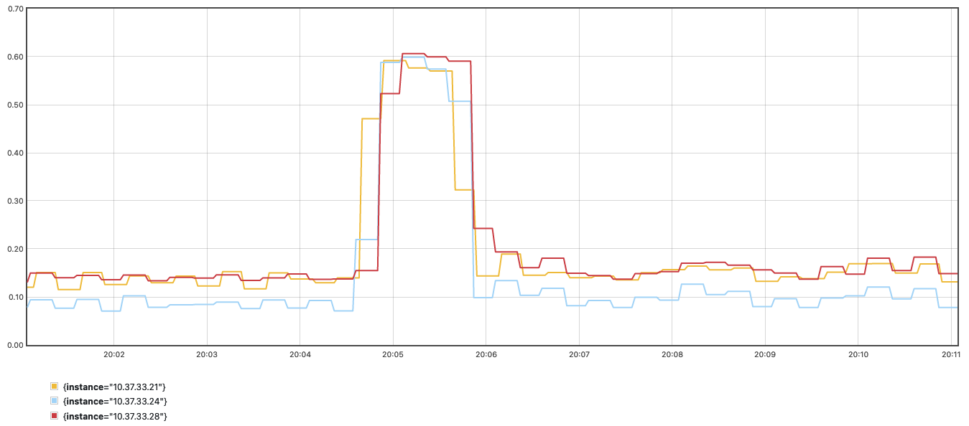
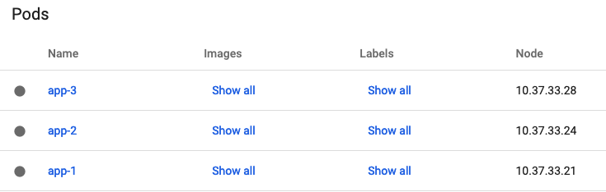
Trimaran-3
60%
utilization
overcommitment
node-21
app-1
node-24
app-2
node-28
app-3
allocated
capacity

Slide 8
Trimaran-3
place app-1:
place app-2:
place app-3:
very light load

